Slide 1
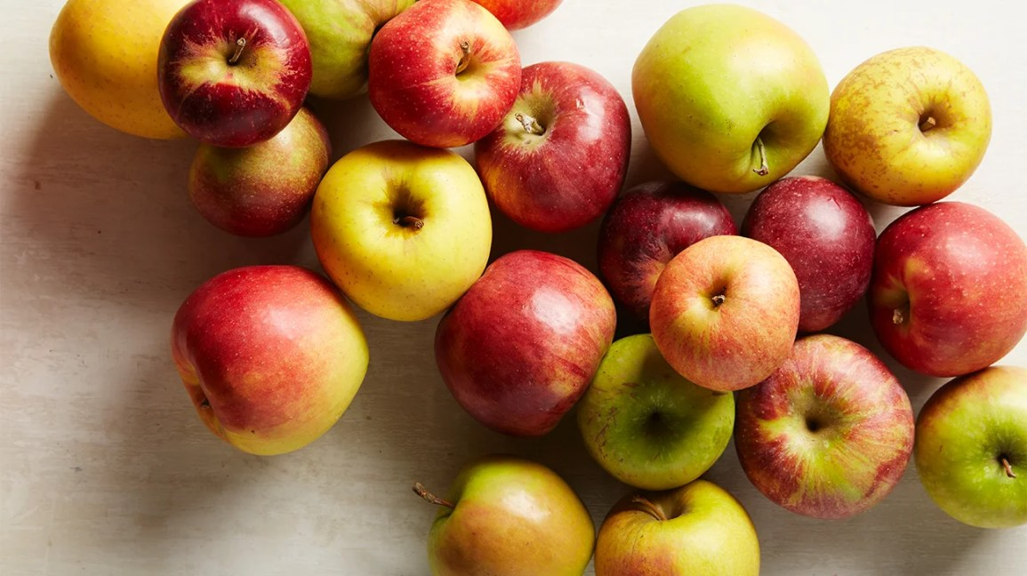
Detection Of Rotten Apples

Slide 2
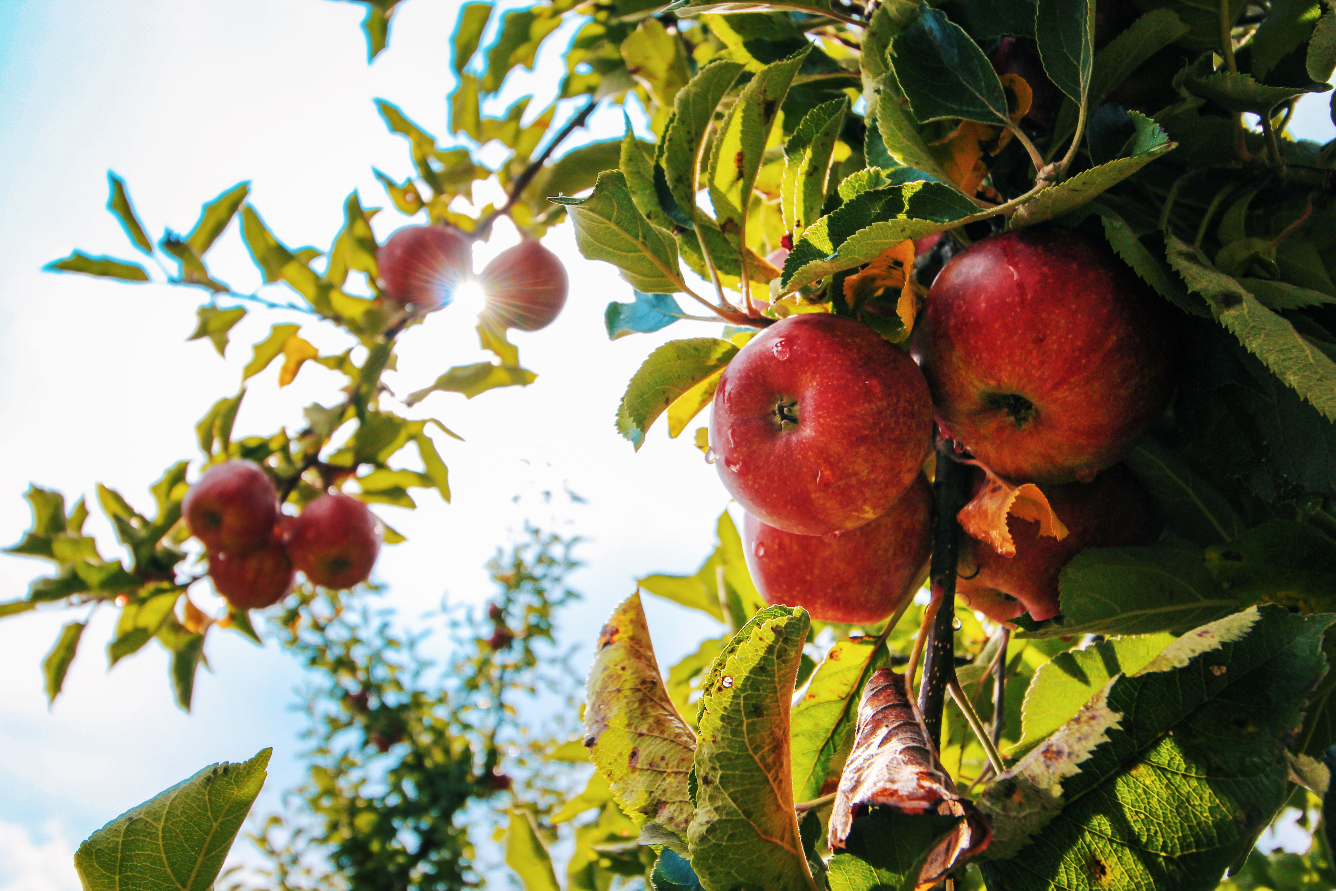
Contents
Problem Statement
Necessity
Objective
CNN
Working
Requirements
Project Scope
UI
Performance Evaluation

Slide 3
Problem Statement
The human eye can detect or analyze the rottenness of fruits, but it is difficult. So, for the easiness of people, we want to develop a desktop application named “Detection of Rotten Fruits” (DRF) by using CNN. The purpose of DRF is to detect and evaluate the accuracy of the rottenness of fruits through images captured through cameras and classify them according to the accuracy of their rottenness.

Slide 4
For Our Project we have used:
Deep Learning Model CNN – Using Python Programming Language
Mobile Application – Using Flutter

Slide 5
About this template
About Project
Necessity
The human eye can detect or analyze the rottenness of apples, but it is difficult. So, for the easiness of people, we want to develop a mobile application named “Detection of Rotten Apples” (DRA) by using CNN. The purpose of Detection of Rotten Apples is to detect and evaluate the accuracy of the rottenness of apples through images captured through cameras and classify them according to the accuracy of their rottenness.
Objective
The problem caused by the uncertainty of the rottenness of apples can be overcome by this creative rottenness detector application without any chemical treatment which could damage the nutritional value. The main objective of the Detection of Rotten Apple’s project is that it can be used by anyone from customers to small-scale vendors. This is an easy-to-use mobile application that helps customers, small-scale industries, and fruit vendors to reduce their efforts of detecting rotten apples manually.

Slide 6
CNN
CNN stands for Convolution neural networks.
It is used for image recognition and classification.
Convolution neural networks are used to do image classification and image recognition in neural networks. Scene labeling, objects detections, face recognition, etc. are some of the areas where convolution Neural Networks are widely used.
A computer sees an image as an array of pixels and depends on the resolution of the image. An RGB image is a 6 * 6 * 3 array of the matrix, and a grayscale image is 4 * 4 * 1 array. Based on image resolution, it will see as h * w * d, where h= height w= width, and d= dimension.
In CNN, each input image will pass through a sequence of convolution layers along with pooling, fully connected layers, and filters. After that, we apply the Soft-max function to classify an object with probabilistic values 0 and 1.

Slide 7
Padding
Padding plays a crucial role in building the convolution neural network. If the image will get shrink and if we will take a neural network with 100's of layers on it, it will give us a small image after filtered in the end. "Padding is an additional layer which can add to the border of an image."
Pooling Layer
Pooling is the "downscaling" of the image obtained from the previous layers. It can be compared to shrinking an image to reduce its pixel density. Spatial pooling is also called down sampling or sub sampling. It reduces the dimensionality of each map but retains the important information.
Max Pooling
Its main objective is to downscale an input representation, reducing its dimensionality. It allows for the assumption to be made about features contained in the sub-region binned. Max pooling is done by applying a max filter to non-overlapping sub-regions of the initial representation.

Slide 8
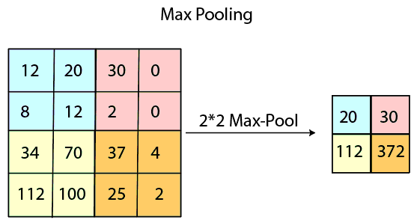

Slide 9
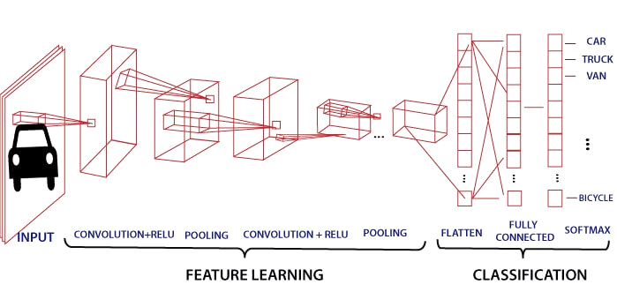

Slide 10
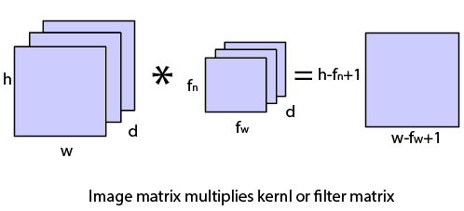
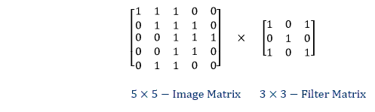
You can also split your content
Working
Convolution Layer
Convolution is a mathematical operation that takes two inputs such as an image matrix and a kernel or filter. The convolution layer is the first layer to extract features from an input image. By learning image features using a small square of input data, the convolution layer preserves the relationship between pixels. The dimension of the image matrix is h×w×d. The dimension of the filter is fh×fw×d and the dimension of the output is (h-fh+1) ×(w-fw+1)×1.

Slide 11
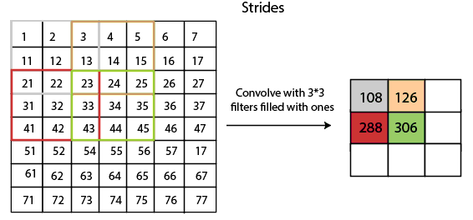
Strides
Strides
Stride is the number of pixels that are shifted over the input matrix. When the stride is equaled to 1, then we move the filters to 1 pixel at a time and similarly if it is equaling to 2 or more, we move them twice as fast. The following figure shows that the convolution would work with stride no 2

Slide 12
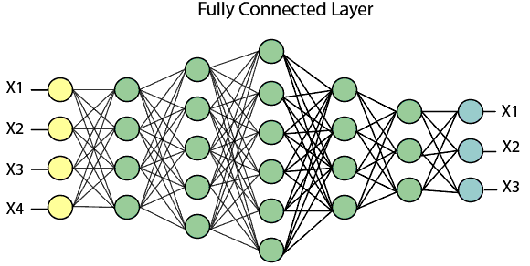
Fully Connected Layer
The fully connected layer is a layer in which the input from the other layers will be flattened into a vector and sent. It will transform the output into the desired number of classes by the network.
In the above diagram, the feature map matrix will be converted into vectors such as X1, X2, X3... Xn with the help of fully connected layers. We will combine features to create a model and apply the activation function such as SoftMax or sigmoid to classify the outputs as a car, dog, truck, etc.

Slide 13




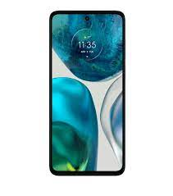

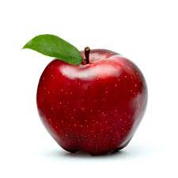
Requirements
Google colab or Jupyter notebook or Vscode
Android Studio
Flutter
Google Drive
Mobile (for the usage of App)
Laptop (System)
Dataset

Slide 14
Project Scope
This App cannot be used for other fruits like oranges, bananas, etc. It is only designed for Fruit ‘Apple’.
This app can be used by anyone either consumers or sellers of Apple of any age group.
One single apple at a time can be detected.
First CNN model is created, and then we designed the app. Finally, integration of the model with the app is done.

Slide 15
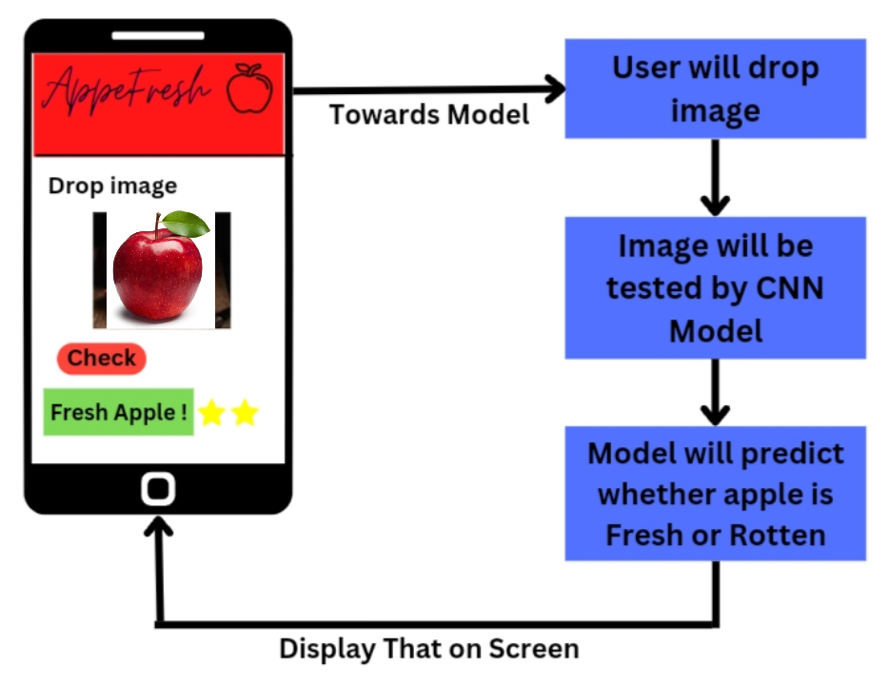

Slide 16
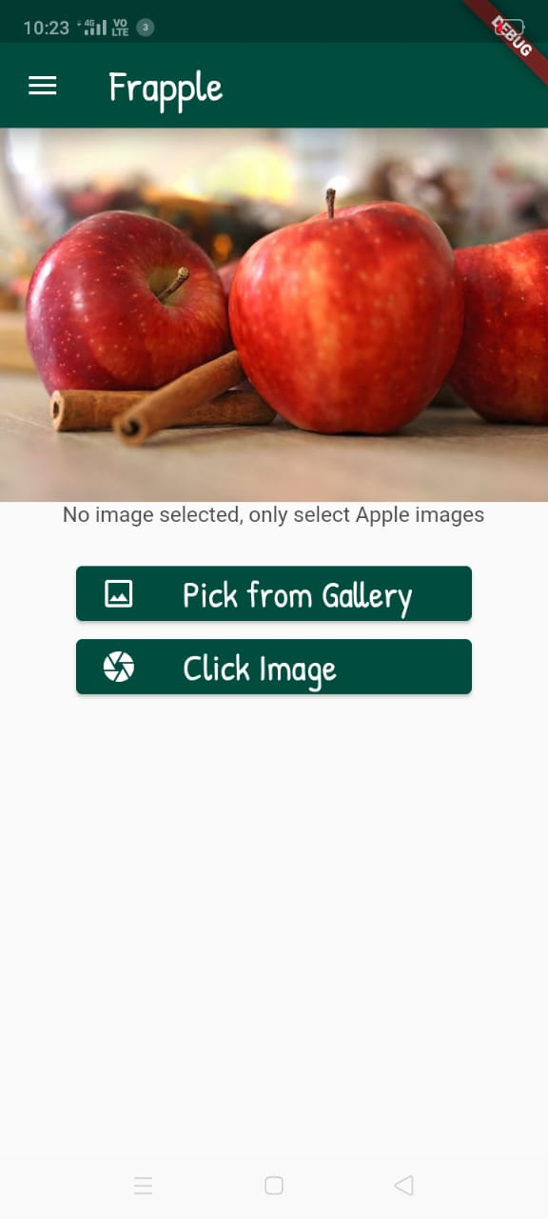
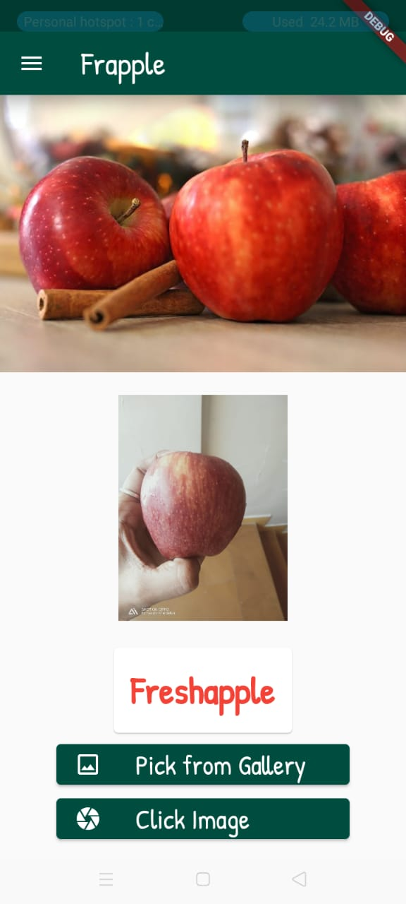
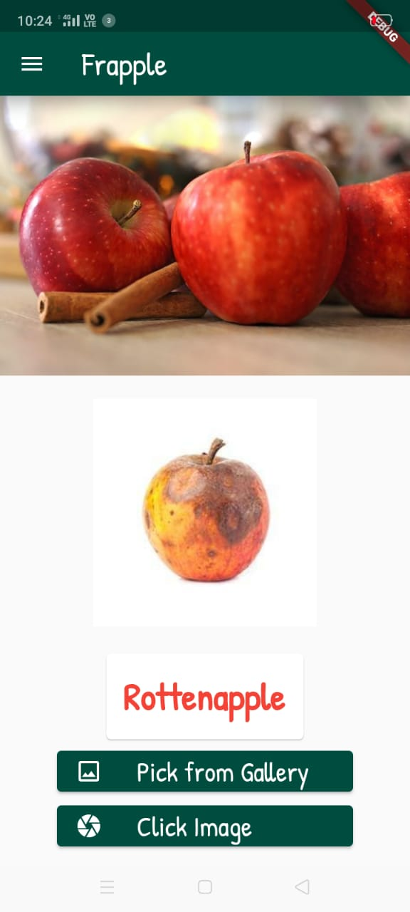
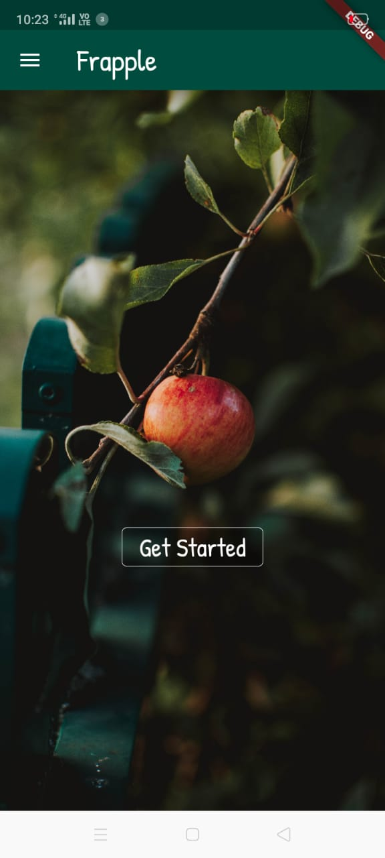
GUI

Slide 17
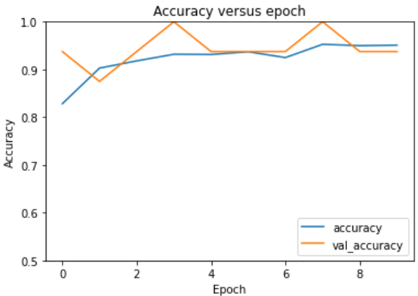
Performance Evaluation
We have calculated the performance of our CNN model by plotting the graph of Accuracy against epoch. Our CNN model is giving accuracy in the range of 90 to 96%. The below graph shows for each epoch what accuracy we have got. The accuracy is in the range of 84 to 96 out of 100.

Slide 18
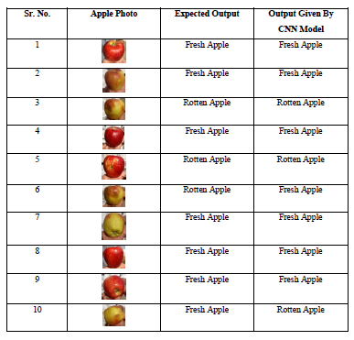

Slide 19
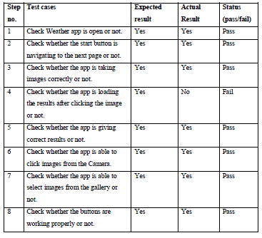

Slide 20
Application and Advantages
Application
App can be used on small scale for detecting freshness of Apple (either by customer or sellers)
Advantages
This App can be used by anyone (Customer as well as the supplier)
It reduces buying time for users to choose Good quality fruits

Slide 21
Future Scope
Future Scope
This project can be easily changed or upgraded in the future as the versions used are mostly compatible with all devices.
By checking the rottenness of apples, we can also predict the same for different fruits by training the model with different images.

Slide 22
Conclusion
In our work, we introduced a model based on CNN and concentrated on building transfer learning models for the task of classification of fresh and rotten apples.
The effects of different hyper-parameters i.e., batch size, number of epochs, optimizer, and learning rate are interrogated in this work.
The results proved that the CNN model proposed can classify fresh and rotten apples firmly and produced better accuracy than transfer learning models.
Thus, the proposed CNN model can automate the process of the human brain in classifying fresh and rotten fruits with the help of the proposed convolution neural network model and thus reduce human errors while classifying fresh and rotten fruits.
An accuracy of 97.82% is attained` for the proposed CNN model.

Slide 23
Thank You !!!
Presentation By -
Sakshi Kherdekar
Sakshi Kakde
Rohit Paritkar

